Slide 1
Python fundamentals
Notes:
Simple, Powerful enough to build real applications

Slide 2
Synopsis
Input and output
Variables
Operators
Keywords
Conditional statements
Functions

Slide 3
Taking input in Python
Python's input() function is used to take user input. By default, it returns the user input in form of a string.
Example:
name = input("Enter your name:")
print("Hello,", name, "! Welcome!")
Output
Enter your name: sivakumar Hello, sivakumar ! Welcome!
Printing Output using print()
print("Hello, World!")
Output:
Hello, World!
Notes:
This is the first step in letting programs talk to users.

Slide 4
Printing Variables
We can use the print() function to print single and multiple variables. We can print multiple variables by separating them with commas.
Take Multiple Input in Python
x, y = input("Enter two values: ").split()
print("Number of boys: ", x)
print("Number of girls: ", y)
x, y, z = input("Enter three values: ").split()
print("Total number of students: ", x)
print("Number of boys is : ", y)
print("Number of girls is : ", z)
Take Single Input in Python
Example:
s = “SIVA"
print(s)
Output: SIVA
s = “Nithin"
age = 25
city = “Bengaluru"
print(s, age, city)
Output:
Siva
Nithin 25 Bengaluru
Output
Enter two values: 5 10 Number of boys: 5 Number of girls: 10 Enter three values: 5 10 15 Total number of students: 5 Number of boys is : 10 Number of girls is : 15
Notes:
print() is used in almost every Python program—it’s your best friend.
“split() lets us take multiple values at once.”
“Everything from usernames to coordinates uses this idea.”
x, y = input("Enter two numbers: ").split()
print(int(x) + int(y))
Make it fun by adding two random audience numbers.

Slide 5
Change the Type of Input in Python
By default, input() function helps in taking user input as string. If any user wants to take input as int or float
Print Names in Python
The code prompts the user to input a string (the color of a rose), assigns it to the variable color and then prints the inputted color.
color = input("What color is rose?: ")
print(color)
Output
What color is rose?: Red
Red
Print Numbers in Python
The code prompts the user to input an integer representing the number of roses, converts the input to an integer using typecasting and then prints the integer value.
n = int(input("How many roses?: "))
print(n)
Output
How many roses?: 88
88
Notes:
“input() gives strings-Python doesn’t guess.”

Slide 6
Print Float or Decimal Number in Python
The code prompts the user to input the price of each rose as a floating-point number, converts the input to a float using typecasting and then prints the price.
price = float(input("Price of each rose?: "))
print(price)
Output
Price of each rose?: 50.3050.3
50.3050.3
Notes:
We convert types manually

Slide 7
Data Type of Input
In these examples, we are printing the type of variable x. We will determine the type of an object in Python.
a = "Hello World"
b = 10
c = 11.22
d = ("Geeks", "for", "Geeks")
e = ["Geeks", "for", "Geeks"]
f = {"Geeks": 1, "for":2, "Geeks":3}
​ print(type(a))
print(type(b))
print(type(c))
print(type(d))
print(type(e))
print(type(f))​
Output
<class 'str'>
<class 'int'>
<class 'float'>
<class 'tuple'>
<class 'list'>
<class 'dict'>
Notes:
“Python has built-in data types for every situation: strings, numbers, lists, dictionaries…”
Use relatable analogies:
List = shopping list
Dictionary = contact list (name → number)

Slide 8

Variables
Notes:
Variables = labeled boxes

Slide 9
In Python, variables are used to store data that can be referenced and manipulated during program execution.
A variable is essentially a name that is assigned to a value.
No need to declare
Everything is a "variable":
Even functions, classes, modules
x = 5
name = “Shiva"
print(x)
print(name)
Output:
5
Shiva
Notes:
“Python variables require no declaration.”
“They are just names pointing to values.”
Can I do this?
age = "Twenty"
Explain dynamic typing.

Slide 10
Rules for Naming Variables
To use variables effectively, we must follow Python’s naming rules:
Variable names can only contain letters, digits and underscores (_).
A variable name cannot start with a digit.
Variable names are case-sensitive like myVar and myvar are different.
Avoid using Python keywords like if, else, for as variable names.
Invalid :
1name = "Error" # Starts with a digit
class = 10 # 'class' is a reserved keyword
user-name = "Doe" # Contains a hyphen
Valid :
age = 21
_colour = "lilac"
total_score = 90
Notes:
“If you break variable naming rules, Python complains loudly.”
Give real examples from coding interviews.
Fun Activity
Ask them to guess which ones are valid:
_name
class
project-name
a1

Slide 11
Assigning Values to Variables
Basic Assignment
Variables in Python are assigned values using the = operator.
x = 5
y = 3.14
z = "Hi"
Multiple Assignments
Python allows multiple variables to be assigned values in a single line.
Assigning the Same Value
Python allows assigning the same value to multiple variables in a single line, which can be useful for initializing variables with the same value.
a = b = c = 100
print(a, b, c)
Output: →100 100 100
Assigning Different Values
We can assign different values to multiple variables simultaneously, making the code concise and easier to read.
x, y, z = 1, 2.5, "Python"
print(x, y, z)
Output: → 1 2.5 Python
Dynamic Typing
Python variables are dynamically typed, meaning the same variable can hold different types of values during execution.
x = 10
x = "Now a string"
Notes:
Python allows fast initialization.
a = b = c = 100
x, y, z = 10, 20, "Python"
print(a, b, c)
print(x, y, z)

Slide 12
Type Casting a Variable
Type casting refers to the process of converting the value of one data type into another. Python provides several built-in functions to facilitate casting, including int(), float() and str() among others.
Basic Casting Functions
int(): Converts compatible values to an integer.
float(): Transforms values into floating-point numbers.
str(): Converts any data type into a string.
s = "10"
n = int(s)
cnt = 5
f = float(cnt)
age = 25
s2 = str(age)
Output:
10
5.0
25
print(n)
print(f)
print(s2)

Slide 13
Getting the Type of Variable
In Python, we can determine the type of a variable using the type() function. This built-in function returns the type of the object passed to it.
n = 42
f = 3.14
s = "Hello, World!"
li = [1, 2, 3]
d = {'key': 'value’}
cool = True
Output:
<class 'int'>
<class 'float'>
<class 'str'>
<class 'list'>
<class 'dict'>
<class 'bool'>
print(type(n))
print(type(f))
print(type(s))
print(type(li))
print(type(d))
print(type(cool))
Delete a Variable Using del Keyword
We can remove a variable from the namespace using the del keyword. This deletes the variable and frees up the memory it was using.
x = 10
print(x)
del x
# Trying to print x after deletion will raise an error
# print(x) # Uncommenting this line will raise NameError: name 'x' is not defined
del x removes the variable x from memory.

Slide 14

Operators

Slide 15
Arithmetic Operators
# Variables
a = 15
b = 4
# Addition
print("Addition:", a + b)
# Subtraction
print("Subtraction:", a - b)
# Multiplication
print("Multiplication:", a * b)
# Division
print("Division:", a / b)
# Floor Division
print("Floor Division:", a // b)
# Modulus
print("Modulus:", a % b)
# Exponentiation
print("Exponentiation:", a ** b)
Output
Addition: 19
Subtraction: 11
Multiplication: 60
Division: 3.75
Floor Division: 3
Modulus: 3
Exponentiation: 50625
Notes:
Operators are tools to manipulate values
Mini Calculator
a = int(input("Enter A: "))
b = int(input("Enter B: "))
print("Add:", a+b)
print("Multiply:", a*b)

Slide 16

Decision-making
Comparison Operators
Assignment Operators
a = 13
b = 33
​print(a > b)
print(a < b)
print(a == b)
print(a != b)
print(a >= b)
print(a <= b)
a = 10
b = a
print(b)
b += a
print(b)
b -= a
print(b)
b *= a
print(b)
Output
10
20
10
100
Output
False
True
False
True
False
True
Logical Operators
Identity Operators
a = True
b = False
print(a and b)
print(a or b)
print(not a)
a = 10
b = 20
c = a
print(a is not b)
print(a is c)
Output
False
True
False
Output
True
True
Notes:
“A student scores 85. Is that > 90? Let's check.”
“is checks whether two names point to the same memory object.”
a = 10
b = 10
print(a is b)

Slide 17

Keywords

Slide 18
Output
The list of keywords are: ['False', 'None', 'True',"__peg_parser__ 'and', 'as', 'assert', 'async', 'await', 'break', 'class', 'continue', 'def', 'del', 'elif', 'else', 'except', 'finally', 'for', 'from', 'global', 'if', 'import', 'in', 'is', 'lambda', 'nonlocal', 'not', 'or', 'pass', 'raise', 'return', 'try', 'while', 'with', 'yield']
import keyword
# printing all keywords using "kwlist()"
print("The list of keywords are : ")
print(keyword.kwlist)
What Happens if We Use Keywords as Variable Names ?
If we attempt to use a keyword as a variable, Python will raise a SyntaxError. Let's look at an example:
for = 10
print(for)
Output
File "/home/latop/india/filename.py", line 1
for = 10
^
SyntaxError: invalid syntax
Notes:
Keywords are reserved—Python uses them internally.
“Why can’t we name a variable ‘class’?”

Slide 19
Category | Keywords
Value Keywords | True, False, None
Operator Keywords | and, or, not, is, in
Control Flow Keywords | if, else, elif, for, while, break, continue, pass, try, except, finally, raise, assert
Function and Class | def, return, lambda, yield, class
Context Management | with, as
Import and Module | import, from
Scope and Namespace | global, nonlocal
Async Programming | async, await

Slide 20
Keywords | Identifiers
Reserved words that have a specific meaning. | Names given to variables, functions, classes, etc.
Cannot be used as variable names. | Can be used as variable names if not a keyword.
Examples: if, else, for, while | Examples: x, number, sum, result
Part of the Python syntax. | User-defined, meaningful names in the code.
Cannot be redefined or changed. | Can be defined and redefined
Keywords | Variables
Reserved words with predefined meanings. | Used to store data.
Cannot be modified or used as variable names. | Can be created, modified, and deleted
Examples: if, while, for | Examples: x, age, name
Used to define the structure of Python code. | Hold values that are manipulated in the program.
Fixed by Python language and cannot be altered. | Must follow naming rules but are otherwise flexible.

Slide 21
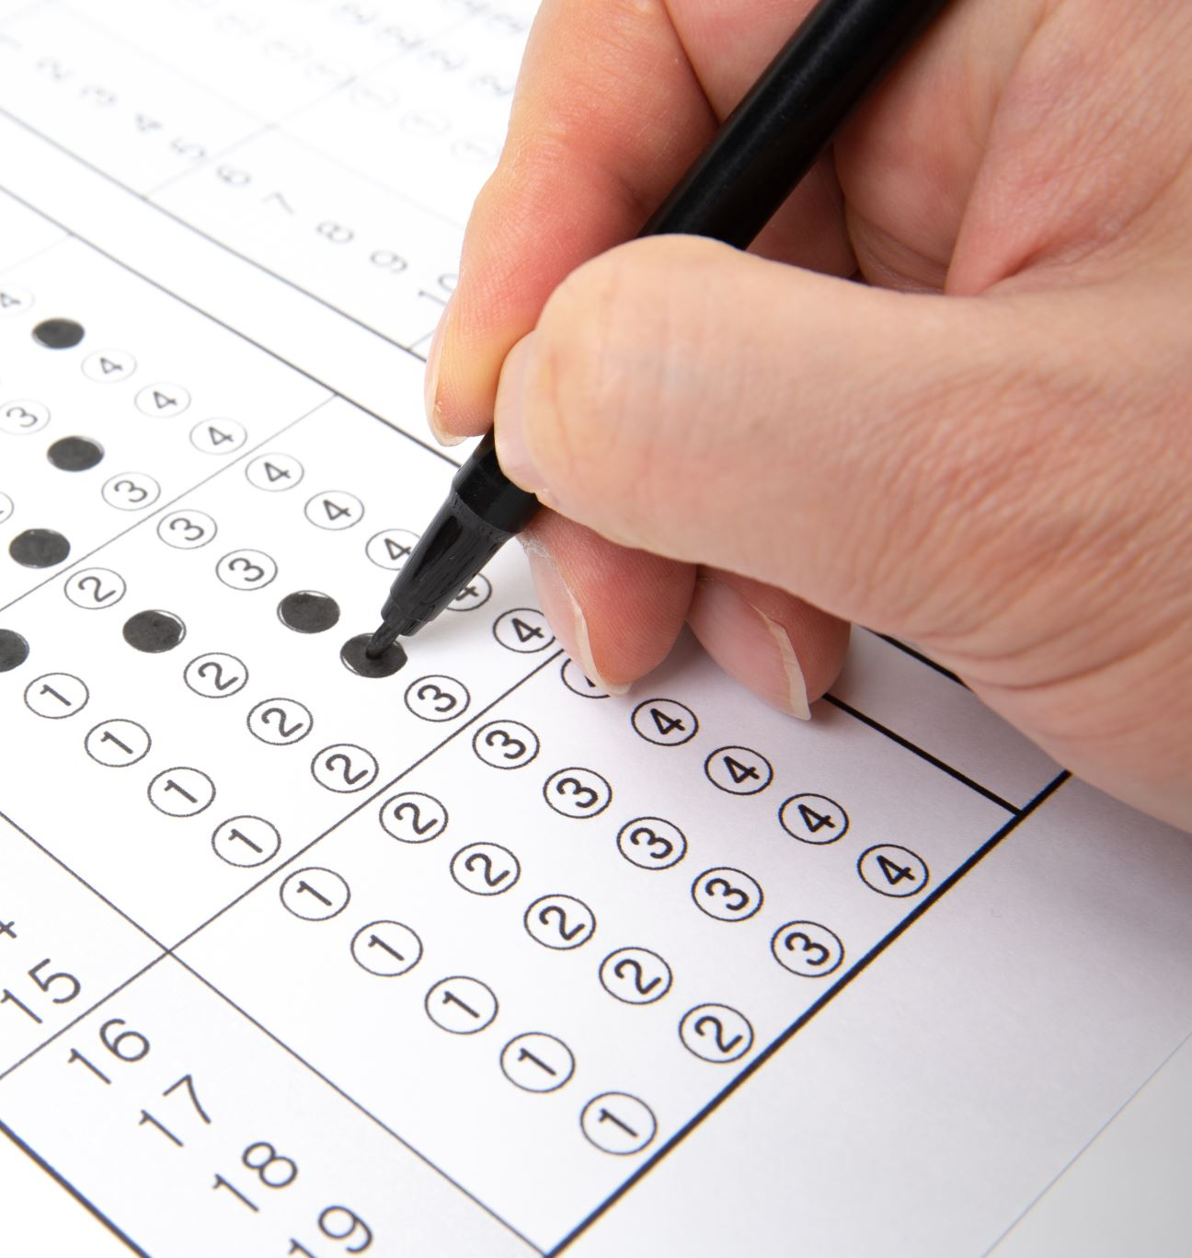
Conditional Statements

Slide 22
Order flow
Condition
if
TRUE
Condition
if
TRUE
FALSE
Condition
elif
FALSE
FALSE
Condition
else
TRUE
Condition
else
Notes:
“if/elif/else is how programs make decisions.”
Use a real-world example: online shopping discount condition.
amount = int(input("Enter bill amount: "))
if amount > 500:
print("You get 10% discount!")
else:
print("No discount.")

Slide 23
For Loop
while Loop
For each item in sequence
Enter while loop
Last
Item reached?
Test Expression
Yes
False
No
True
Exit Loop
Exit Loop
Body of for loop
Body of while loop
Notes:
“Loops automate repetition.”
“Use for loops when you know how many times. Use while when you don’t.”
for i in range(5):
print(“Loop", i)
“What if I change range(5) to range(10)?”

Slide 24
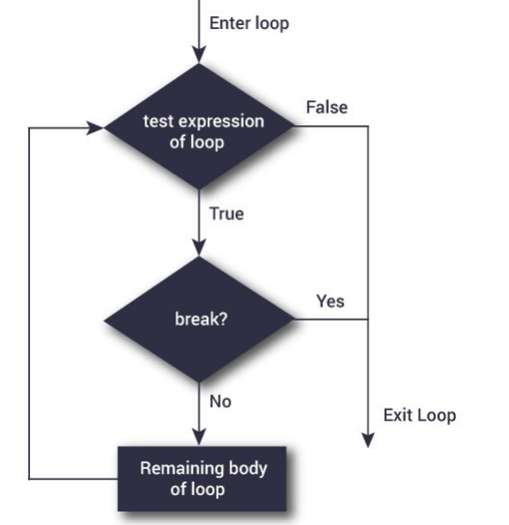
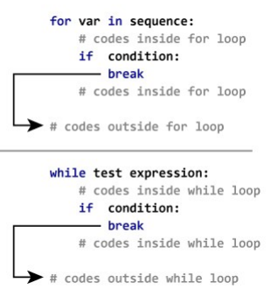

Slide 25
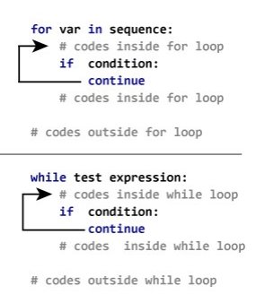
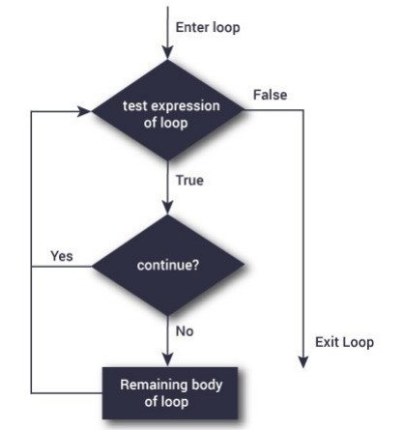

Slide 26

Functions
Notes:
Functions = ATM machines (input → process → output)

Slide 27
Functions are a block of statements that does a specific task.
The idea is to put some commonly or repeatedly done task together and make a function so that instead of writing the code repeatedly for different inputs, we can do the function calls to reuse code contained in it
Function Arguments
def evenOdd(x):
if (x % 2 == 0):
return "Even"
else:
return "Odd"
print(evenOdd(16))
print(evenOdd(7))
Output
Even
Odd
def function_name (parameters):
# statement
return expression
Calling a Function
def fun():
print("Welcome to the world of Kantara")
fun() # Driver code to call a function
Output
Welcome to the world of Kantara
Notes:
“Functions help you reuse code instead of writing again and again.”
“Think of them like packaged actions.”
def greet(name):
print("Hello", name)
greet("Siva")

Slide 28
Types of Function Arguments
Default Arguments
def myFun(x, y=50):
print("x: ", x)
print("y: ", y)
myFun(10)
Output
x: 10
y: 50
Keyword Arguments
def student(fname, lname):
print(fname, lname)
student(fname=‘Engi', lname=‘grad')
student(lname=‘Data', fname=‘Data2’)
Output
Engi grad
Data Data2
Positional Arguments
def nameAge(name, age):
print("Hi, I am", name)
print("My age is ", age)
print(“student1:")
nameAge("Suraj", 27)
print("\nstudent2:")
nameAge(27, "Suraj")
Output
student1:
Hi, I am Suraj
My age is 27
student2:
Hi, I am 27
My age is Suraj

Slide 29
Arbitrary Arguments
Syntax Meaning
*args Accepts multiple non-keyword arguments (tuple)
**kwargs Accepts multiple keyword arguments (dictionary)
def show_fruits(*args):
for item in args:
print(item)
show_fruits("Apple", "Mango", "Banana")
Output
Apple
Mango
Banana
def show_details(**kwargs):
for key, value in kwargs.items():
print(key, ":", value)
show_details(name="Siva", age=38, city="Bengaluru")
Output
name : Siva
age : 38
city : Bengaluru

Slide 30

lambda

Slide 31
A lambda function is a small, anonymous (nameless) function It is used when we need a function for a short period of time.
lambda arguments: expression
square = lambda x: x * x
print(square(5))
# 25
Key Points
One-line function
Can have any number of arguments
Only one expression (no multiple statements)
add = lambda a, b: a + b
print(add(3, 7))
# 10
Why use Lambda?
For quick, simple operations
Used with functions like map(), filter(), sorted()
is_even = lambda n: n % 2 == 0
print(is_even(8))
# True
Notes:
Useful for tiny, one-time operations.
Used together with map, filter, sorted
square = lambda x: x * x
print(square(6))

